Slide 1
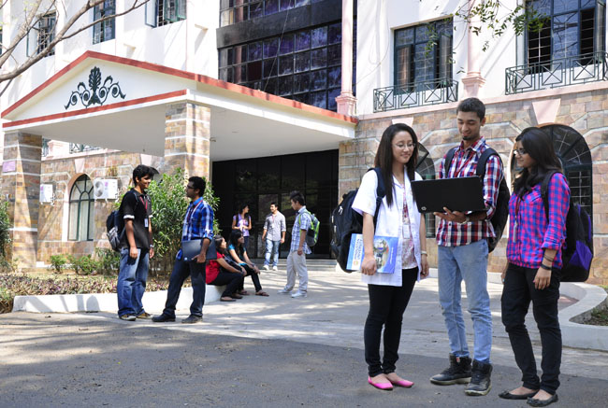

CSB4201 - DESIGN AND ANALYSIS AND ALGORITHMS
B.Tech – III Semester – Unit I
Dr. J. ThangakumarAssociate professor
School of Computing Sciences,
Department of Computer Science and Engineering
Mr. M Sambath
Assistant Professor(SG)
School of Computing Sciences,
Department of Computer Science and Engineering

Slide 2
Lecture 1 Topic : Introduction and motivation

Slide 3

ORDERED ROOM
WHY??
ADVANTAGEOUS OR NOT ?
IF SO WHAT ARE THE
ADVANTAGES?
1. Easy to Search / Locate
2. Easy to Insert new item
3. Easy to Remove existing
item

Slide 4


What is data ?
Data is collection of raw facts refers to alphabets, numbers or symbols
Example : A set of Integers = { 60, 63, 56 }
Marks of Joe in 3 subjects
60 - Physics
63 - Chemistry
56 - Mathematics
The way of organising the data in the memory
of the computer is called data structure

Slide 5

Use of appropriate data structure enables a computer system to perform its task more efficiently, by influencing the ability of computer to store and retrieve data from any location in its memory. Different kind of data structures are suited to different computer applications and tasks.

Slide 6
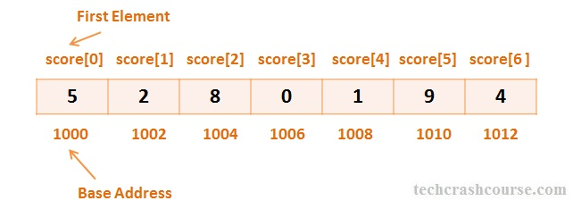
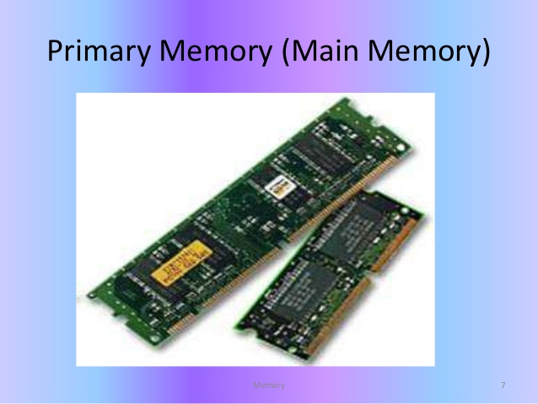
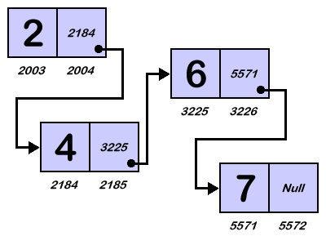
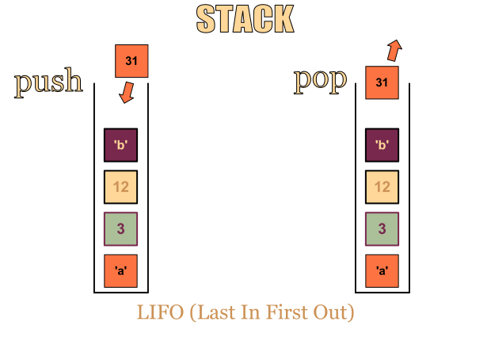
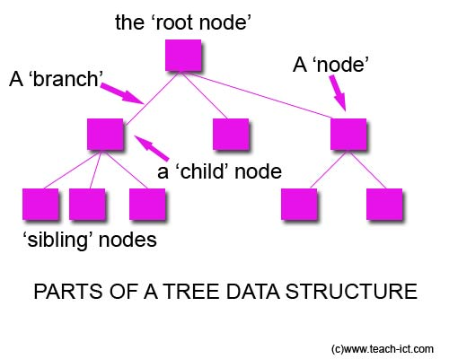
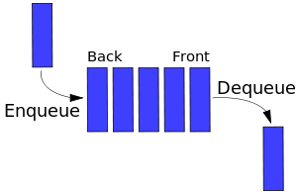
Data Structure
A data structure is a particular way of organizing the data in the memory of the computer so that it can be used efficiently
Lists
Tree

Slide 7


Secondary Memory
FILE

Slide 8
Types of Data Structures
Abstract Data Type (ADT)
{ Attributes :
Set of elements of certain Size
Functions:
Insertion
Deletion
Search
Display }
Data Structure
Linear
Non-Linear
Relationship
Between the
data
Automobile
Hierarchical –
Parent Child
10 | 20 | 5 | 23 | 0 | 15
Car
Bus
Lists
Stack
Queue
Tree
Graph

Slide 9
Fundamentals of Algorithm and Problem Solving
Understand the problem
Decide on computational means (exact or approximate) ,Data structures, Algorithm Design Techniques
Design an algorithm
Prove Correctness
Analyze the Algorithm
Coding

Slide 10
Algorithm for making sambar
Data Needed
Toor dhal
Onion
Tomato
Mustard seed
Fenugreek
Oil
Salt
Tamarind
Sambar powder

Slide 11
Algorithm for making sambar
Procedure
Cook toor dhal in pressure pan
Boil onion and tomato
Add boiled onion and tomato to toor dhal
Add tamarind water, sambar powder and salt to the ingredients prepared in step 4
Heat a tea spoon of oil add mustard seed and fenugreek seed.
Allow mustard seed to flutter

Slide 12
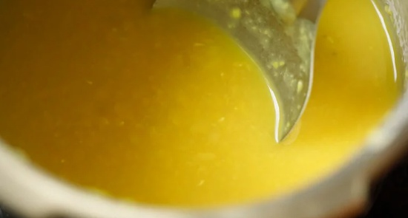
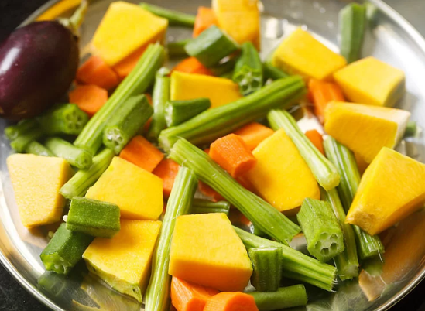
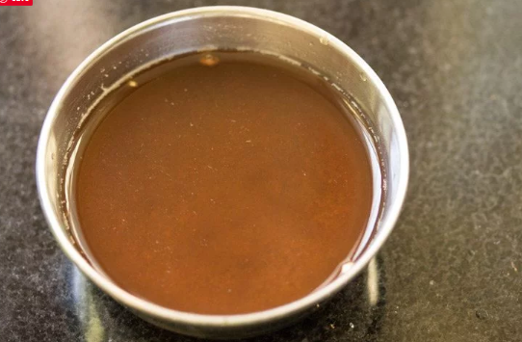
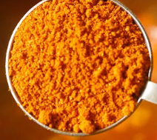
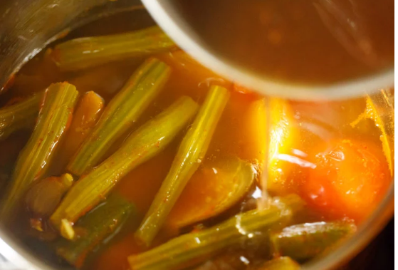

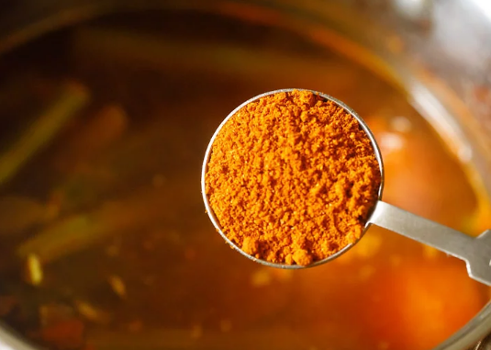

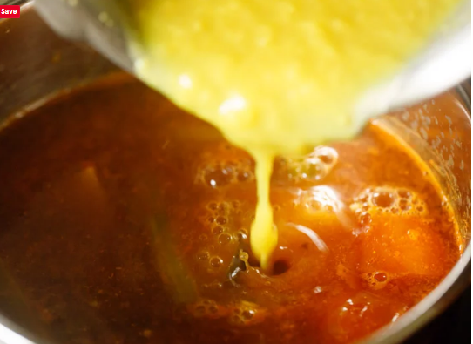


Slide 13
How to Choose Data Structures?
Fundamental requirements –
What are the inputs?
What are the outputs?
What are the operations in between? Then, the performance and scale requirements –
How much data are we talking about?
How frequently will it be accessed?

Slide 14
Notion of algorithm and problem
Problem
algorithm
“computer”
Input
(or instance)
Output
Algorithmic solution
(different from a conventional solution)

Slide 15
Algorithm
An algorithm is a sequence of unambiguous instructions for solving a problem, i.e., for obtaining a required output for any legitimate input in a finite amount of time.
Can be represented various forms
Unambiguity/clearness
Effectiveness
Finiteness/termination
Correctness

Slide 16
Algorithm design strategies
Brute force
Divide and conquer
Decrease and conquer
Transform and conquer
Greedy approach
Dynamic programming
Backtracking and branch-and-bound
Space and time tradeoffs

Slide 17
Analysis of Algorithms
How good is the algorithm?
Correctness
Time efficiency
Space efficiency
Does there exist a better algorithm?
Lower bounds
Optimality

Slide 18
What is an algorithm?
Recipe, process, method, technique, procedure, routine,… with the following requirements:
Finiteness
terminates after a finite number of steps
Definiteness
rigorously and unambiguously specified
Clearly specified input
valid inputs are clearly specified
Clearly specified/expected output
can be proved to produce the correct output given a valid input
Effectiveness
steps are sufficiently simple and basic
Notes:
The formalization of the notion of an algorithm led to great breakthroughs in the
foundations of mathematics in the 1930s.

Slide 19
Why study algorithms?
Theoretical importance
The core of Computer science
Practical importance
A practitioner’s toolkit of known algorithms
Framework for designing and analyzing algorithms for new problems
Example: Google’s PageRank Technology

Slide 20
Algorithm design techniques/strategies
Brute force
Divide and conquer
Decrease and conquer
Transform and conquer
Space and time tradeoffs
Greedy approach
Dynamic programming
Iterative improvement
Backtracking
Branch and bound

Slide 21
Analysis of algorithms
How good is the algorithm?
time efficiency
space efficiency
correctness ignored in this course
Does there exist a better algorithm?
lower bounds
optimality

Slide 22
Important problem types
sorting
searching
string processing
graph problems
combinatorial problems
geometric problems
numerical problems

Slide 23

Surprise Quiz
https://forms.gle/rJaEH9wcQtHEoYcdA

Slide 24
Lecture 2 Topic :Input size

Slide 25
Analysis of algorithms
Issues:
correctness
time efficiency
space efficiency
Optimality
Approaches:
theoretical analysis
empirical analysis

Slide 26
Theoretical analysis of time efficiency
Time efficiency is analyzed by determining the number of repetitions of the basic operation as a function of input size
Basic operation: the operation that contributes the most towards the running time of the algorithm
T(n) ≈ c_{op}C(n)
input size
running time
Number of times basic operation is executed
execution time
for basic operation
or cost
Note: Different basic operations may cost differently!

Slide 27
Input size and basic operation examples
Problem | Input size measure | Basic operation
Searching for key in a list of n items | Number of list’s items, i.e. n | Key comparison
Multiplication of two matrices | Matrix dimensions or total number of elements | Multiplication of two numbers
Checking primality of a given integer n | n’size = number of digits (in binary representation) | Division
Typical graph problem | #vertices and/or edges | Visiting a vertex or traversing an edge

Slide 28
Basic asymptotic efficiency classes
1 | constant
log n | logarithmic
n | linear
n log n | n-log-n
n² | quadratic
n³ | cubic
2^{n} | exponential
n! | factorial

Slide 29
Best-case, average-case, worst-case
For some algorithms, efficiency depends on form of input:
Worst case: C_{worst}(n) – maximum over inputs of size n
Best case: C_{best}(n) – minimum over inputs of size n
Average case: C_{avg}(n) – “average” over inputs of size n
Number of times the basic operation will be executed on typical input
NOT the average of worst and best case
Expected number of basic operations considered as a random variable under some assumption about the probability distribution of all possible inputs. So, avg = expected under uniform distribution.

Slide 30
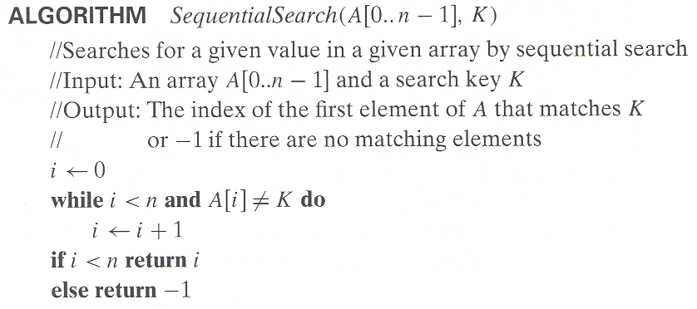
Example: Sequential search
Worst case
Best case
Average case
n key comparisons
1 comparisons
(n+1)/2, assuming K is in A

Slide 31
Types of formulas for basic operation’s count
Exact formula
e.g., C(n) = n(n-1)/2
Formula indicating order of growth with specific multiplicative constant
e.g., C(n) ≈ 0.5 n²
Formula indicating order of growth with unknown multiplicative constant
e.g., C(n) ≈ cn²

Slide 32
Asymptotic order of growth
A way of comparing functions that ignores constant factors and small input sizes (because?)
O(g(n)): class of functions f(n) that grow no faster than g(n)
Θ(g(n)): class of functions f(n) that grow at same rate as g(n)
Ω(g(n)): class of functions f(n) that grow at least as fast as g(n)

Slide 33
Activity https://visualgo.net/en

Slide 34
Lecture 3 Topic :Asymptotic Notations

Slide 35
Ω-notation
Formal definition
A function t(n) is said to be in Ω(g(n)), denoted t(n) ∈ Ω(g(n)), if t(n) is bounded below by some constant multiple of g(n) for all large n, i.e., if there exist some positive constant c and some nonnegative integer n₀ such that
t(n) ≥ cg(n) for all n ≥ n₀
Exercises: prove the following using the above definition
10n² ∈ Ω(n²)
0.3n² - 2n ∈ Ω(n²)
0.1n³ ∈ Ω(n²)

Slide 36
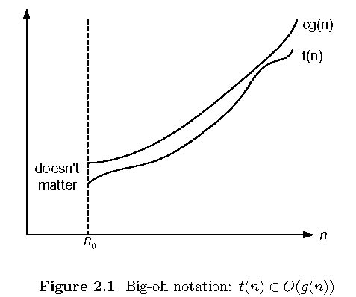
Big-oh

Slide 37
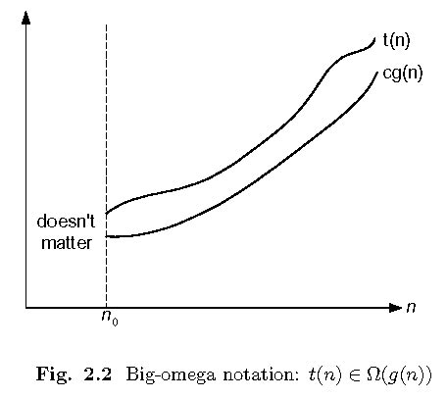
Big-omega

Slide 38
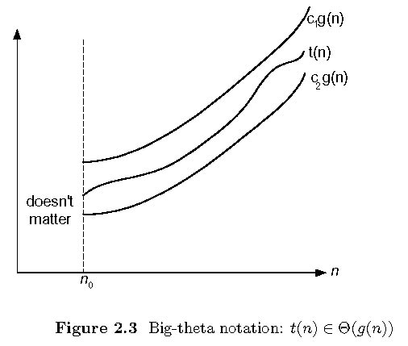
Big-theta

Slide 39
Establishing order of growth using the definition
Definition: f(n) is in O(g(n)), denoted f(n) ∈ O(g(n)), if order of growth of f(n) ≤ order of growth of g(n) (within constant multiple), i.e., there exist positive constant c and non-negative integer n₀ such that
f(n) ≤ c g(n) for every n ≥ n₀
Examples:
10n is in O(n²)
5n+20 is in O(n)
Notes:
Examples:
10n is O(n²)
since 10n ≤ 10n² for n ≥ 1 or 10n ≤ n² for n ≥ 10
c n₀
5n+20 is O(10n)
since 5n+20 ≤ 10 n for n ≥ 4
c n₀

Slide 40
Ω-notation
Formal definition
A function t(n) is said to be in Ω(g(n)), denoted t(n) ∈ Ω(g(n)), if t(n) is bounded below by some constant multiple of g(n) for all large n, i.e., if there exist some positive constant c and some nonnegative integer n₀ such that
t(n) ≥ cg(n) for all n ≥ n₀
Exercises: prove the following using the above definition
10n² ∈ Ω(n²)
0.3n² - 2n ∈ Ω(n²)
0.1n³ ∈ Ω(n²)

Slide 41
Θ-notation
Formal definition
A function t(n) is said to be in Θ(g(n)), denoted t(n) ∈ Θ(g(n)), if t(n) is bounded both above and below by some positive constant multiples of g(n) for all large n, i.e., if there exist some positive constant c₁ and c₂ and some nonnegative integer n₀ such that
c₂ g(n) ≤ t(n) ≤ c₁ g(n) for all n ≥ n₀
Exercises: prove the following using the above definition
10n² ∈ Θ(n²)
0.3n² - 2n ∈ Θ(n²)
(1/2)n(n+1) ∈ Θ(n²)

Slide 42
Activity: Match the Following
1 | linear
log n | n-log-n
n | quadratic
n log n | cubic
n² | exponential
n³ | factorial
2^{n} | Constant
n! | Lograthamic

Slide 43
Lecture 4 Topic :Recursive Algorithms

Slide 44
Recursive Algorithms
Recurrences are useful for analyzing recursive algorithms
Recurrence – an equation or inequality that describes a function in terms of its value on smaller inputs

Slide 45
An Example
MergeSort
T(n) = Θ(1) if n = 1
2T(n/2) + Θ(n) if n > 1
= Θ(nlgn)

Slide 46
Solution Techniques (cont)
In general we can ignore
Floors and ceilings
Size of input is usually an integer
Boundary conditions
An algorithm runs in constant time on constant-sized input
When boundary condition changes
it is usually by a constant factor
it does not affect the order of growth

Slide 47
Substitution Method
For upper or lower bounds
Substitution Method:
1. Guess the form of the solution
2. Prove using mathematical induction

Slide 48
Substitution Method (cont)
Example: Solve T(n) = 2T(^{n}/₂) + n
Guess: T(n) = Ο(nlgn)
Since recurrence is similar to MergeSort
Show: T(n) ≤ cnlgn for some c > 0
Assume: it holds for T(^{n}/₂) ≤ c(^{n}/₂)lg(^{n}/₂)
Substitute: this into the original recurrence

Slide 49
Substitution Method (cont)
T(n) ≤ 2(c(^{n}/₂)lg(^{n}/₂)) + n
≤ cnlg (^{n}/₂) + n
= cnlgn – cnlg2 + n
= cnlgn – cn + n
Now we want T(n) ≤ cnlgn
To accomplish this, we want (– cn + n) ≤ 0
Thus, n ≤ cn
1 ≤ c
T(n) ≤ cnlgn for c ≥ 1
By identity on page 53. Also note that lg2 = 1.
Original equation that we wanted to “show”

Slide 50
Substitution Method (cont)
Now check boundary conditions
Assume T(1) = 1
Then T(1) = 1 ≤ c(1)lg(1) = 0 → OOPS!
We are not constrained to show for n ≥ 1, but for n ≥ n₀
Extend boundary conditions
T(1) = 1
T(2) = 2T(1) + 2 = 4 T(3) = 2T(1) + 3 = 5
T(2) ≤ c2lg2 = 2c T(3) ≤ c3lg3 = 4.755c
c ≥ 2 c ≥ 1.05
For the base cases to hold, any choice of c ≥ 2 will suffice
Base case of recurrence
Base cases for inductive proof

Slide 51
Substitution Method (cont)
Making good guesses
Guess similar solutions to similar recurrences
T(n) = 2T(^{n}/₂ + 42) + n
Guess that T(n) = Ο(nlgn)
The +42 makes no difference when n is very large
You’re still cutting the input in half
Narrow in on solutions using loose upper and lower bounds
Ω(n) ➔ Θ(nlgn) ⬅ Ο(n²)

Slide 52
Substitution Method (cont)
Problem: Lower-order terms may defeat mathematical induction of substitution method
T(n) = 2T(^{n}/₂) + 1
Guess: T(n) = Ο(n)
Show: T(n) ≤ cn for some c > 0
Assume: T(^{n}/₂) ≤ c(^{n}/₂)

Slide 53
Substitution Method (cont)
Substitute: into original recurrence
T(n) ≤ 2c(^{n}/₂) + 1
= cn + 1
≤ cn
i.e. it is NOT the same as what we were trying to show
and we cannot just remove the +1

Slide 54
Substitution Method (cont)
Try subtracting a lower-order term
Make a stronger inductive hypothesis
We know that cn – b ∈ Ο(n)
Guess: T(n) = Ο(n)
Show: T(n) ≤ cn - b where b ≥ 0 is some constant
Assume: T(^{n}/₂) ≤ c(^{n}/₂) – b

Slide 55
Substitution Method (cont)
Substitute: into original recurrence
T(n) = 2T(^{n}/₂) + 1
T(n) ≤ 2(c^{n}/₂ - b) + 1
= cn –2b +1
≤ cn – b
cn –2b + 1 will be less than
cn – b
if b ≥ 1

Slide 56
Substitution Method (cont)
Example: Factorial
Fact(n)
if n < 1
return 1
else
return n * fact(n-1)
T(n) = Θ(1) if n = 0
T(n-1) + Θ(1) if n > 0

Slide 57
Substitution Method (cont)
Guess: T(n) = Ο(n)
Show: T(n) ≤ cn
Assume: T(n-1) ≤ c(n-1)
Substitute: T(n) ≤ c(n-1) + Θ(1)
= cn – c + Θ(1)
≤ cn
Boundary conditions:
T(1) = Θ(1) ≤ cn = c 
if c ≥ Θ(1) which is true for large enough c

Slide 58
Substitution Method (cont)
Example: Fibonacci
Fib(n)
if n < 2
return n
else
return Fib(n-1) + Fib(n-2)
T(n) = 1 if n < 2
T(n-1) + T(n-2) + Θ(1) if n ≥ 2

Slide 59
Substitution Method (cont)
Guess: T(n) = Ο(2^{n})
Show: T(n) ≤ c2^{n}
Assume: T(n-1) ≤ c(2^{n-1}) & T(n-2) ≤ c(2^{n-2})
Substitute: T(n) ≤ c(2^{n-1}) + c(2^{n-2}) + Θ(1)
= ½c2^{n} + ¼c2^{n} + Θ(1)
= ¾c2^{n} + Θ(1)
≤ c2^{n}
Boundary Conditions
T(0) = 1 ≤ c2⁰ = c if c ≥ 1
Actually,
if
¼c2^{n} ≥ Θ(1)
c ≥ (4Θ(1))/2^{n}
which holds for sufficiently large n

Slide 60
Activity https://visualgo.net/en

Slide 61
Lecture 5 Topic :Recursion Tree Method

Slide 62
Recursion-Tree Method
Helps to generate a “good guess”
Can be a little mathematically sloppy because:
Then prove using substitution method
Can be used as a direct proof if done carefully
Helps visualize the recursion

Slide 63
Recursion-Tree Method (cont)
Here is sloppiness we can tolerate
Example
Rewrite as: T(n) = 3T(n/4) + cn²
implied constant coefficient c > 0
T(n)
cn²
T(n/4)
T(n/4)
T(n/4)

Slide 64
Recursion-Tree Method (cont)
cn²
c(n/4)²
c(n/4)²
c(n/4)²
T(n/16)
T(n/16)
T(n/16)
T(n/16)
T(n/16)
T(n/16)
T(n/16)
T(n/16)
T(n/16)

Slide 65
Recursion-Tree Method (cont)
cn²
cn²
log₄n
c(n/4)²
c(n/4)²
c(n/4)²
³/₁₆ cn²
c(n/16)²
c(n/16)²
c(n/16)²
c(n/16)²
c(n/16)²
c(n/16)²
c(n/16)²
c(n/16)²
c(n/16)²
(³/₁₆)²cn²
.
.
.
.
.
.
.
.
.
.
.
.
.
.
.
.
.
.
.
.
.
.
.
.
.
.
.
.
.
.
T(1)
T(1)
T(1)
T(1)
T(1)
T(1)
…
T(1)
T(1)
T(1)
T(1)
Total: Ο(n²)

Slide 66
Recursion-Tree Method (cont)
How did we get the total of Ο(n²)
But this is a little messy

Slide 67
Recursion-Tree Method (cont)
Use an infinite decreasing geometric series as an upper bound
Again, a little sloppy, but OK for a guess

Slide 68
Recursion-Tree Method (cont)
Now use substitution method to check
Guess: T(n) = Ο(n²)
Show: T(n) ≤ dn² for some constant d > 0
Assume: T(n/4) = d(n/4)²

Slide 69
Recursion-Tree Method (cont)
Same c as in slide 20
Holds as long as d ≥ (16/13)c

Slide 70
Recursion-Tree Method (cont)
Another Example
Find the upper-bound
Again, c will represent Ο(n)

Slide 71
Recursion-Tree Method (cont)
cn
cn
log_{3/2}n
c(n/3)
c(2n/3)
cn
c(n/9)
c(2n/9)
c(2n/9)
c(4n/9)
cn
T(1)
?
T(1)
T(1)
T(1)
?
Total: Ο(nlgn)

Slide 72
Recursion-Tree Method (cont)
Some complications in this example:
The tree is not a complete binary tree
Each level will not contribute a cost of cn
Levels toward the bottom contribute less
But we want only a “guess,” so this imprecision is OK
Now check using the Substitution Method

Slide 73
Activity https://visualgo.net/en

Slide 74
Lecture 6 Topic :Master Method

Slide 75
Master Method
Solves recurrences of the form
a ≥ 1, b > 1 are constants
f(n) is an asymptotically positive function

Slide 76
Master Theorem
Let a ≥ 1 and b > 1 be constants, let f(n) be a function, and let T(n) be defined on the nonnegative integers by the recurrence where we interpret n/b to mean either ⎣n/b⎦ or ⎡n/b⎤. Then T(n) can be bounded asymptotically as follows.

Slide 77
Master Theorem (cont)
If for some constant ε > 0, then
If then
If for some constant ε > 0, and if for some constant c < 1 and all sufficiently large n, then

Slide 78
Master Method (cont)
Which is larger, f(n) or ?
By a factor of or polynomially larger...

Slide 79
Master Method (cont)
Example:
Case 2

Slide 80
Master Method (cont)
Example:
Case 1

Slide 81
Master Method (cont)
Case 3
Example:
now check that for large n,

Slide 82
Summary Example
Use all three methods:
T(n) = Θ(1) if n ≤ 2 2T(n/2) + n³ if n > 2

Slide 83
Summary Example (cont)
Master Method
for large n, is
Case 3

Slide 84
Summary Example (cont)
Substitution Method (cont)
Guess: T(n) = Ω(n³)
Show: T(n) ≥ cn³
Assume: T(n/2) ≥ c(n/2)³
Substitute:

Slide 85
Summary Example (cont)
Substitution Method (cont)
Boundary conditions:

Slide 86
Summary Example (cont)
Substitution Method (cont)
Thus, c must equal ⁴/₃
and T(n) = Θ(n³)

Slide 87
Summary Example (cont)
Recursion Tree Method
n³
n³
(n/2)³
(n/2)³
¹/₄ n³
(n/4)³
(n/4)³
(n/4)³
(n/4)³
(¹/₄)²n³
.
.
.
.
.
.
.
.
.
.
.
.
.
.
.
T(1)
T(1)
T(1)
T(1)
…
T(1)
T(1)
T(1)
T(1)
Θ(n)
Total: Ο(n³)

Slide 88
ACTIVITY
What is the complexity of T(n) = T(n-1) + 1/n(n-1)
Θ( ¹⁄_{n} )
Θ( ¹⁄_{n}² )
Θ( 1 )
Θ( ln( n ) )

Slide 89
Summary
What is the need of algorithms
What is an Input size of an algorithm
How to analyze worst case and best case of algorithms
How to represent the quantitative efficiencies using asymptotic notations
References
1. Introduction to Design and analysis of algorithms, 2nd Edition, Anany Levitin

Slide 90
THANK YOU

